Slide 1
Chapter 1 Basic Concepts
簡廷因 2020.09.15

Slide 2
108 中央
The following procedure recursively generates all the permutations of list[i] to list[n].
void perm (char *list, int i, int n)
{
int j, temp;
if (i = = n)
{
for (j =0; j <= n; j++)
printf(“%c”, list[j]);
printf(“ ”);
}
else {
for (j = i ; j <= n ; j++)
{
(B1)
(B2)
SWAP(list[i], list[j], temp);
}}}
Blank (B1) in the algorithm above should be (5%)?
Blank (B2) in the algorithm above should be (5%)?

Slide 3
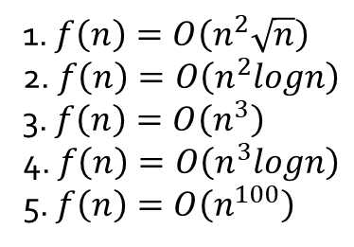
109 台大
Let f(n) be the number of additions in the following algorithm.
______________________________________________________
for i = 1 to n do
for j = 1 to i do
for k = 1 to j do
C[i][j][k] = A[i][j][k] + B[i][j][k];
end for
end for
end for
______________________________________________________
1. $f\left(n\right)=O\left(n^{2}\sqrt{n}\right)$
2. $f\left(n\right)=O\left(n^{2}logn\right)$
3. $f\left(n\right)=O\left(n^{3}\right)$
4. $f\left(n\right)=O\left(n^{3}logn\right)$
5. $f\left(n\right)=O\left(n^{100}\right)$

Slide 4
93 交大
Please order the following function by growth rate in increasing order: N, SQRT(N), N^{1.5}, N² , NlogN, Nlog(logN), Nlog²N, Nlog(N²), 2^{n}, 29, N²logN, N³

Slide 5
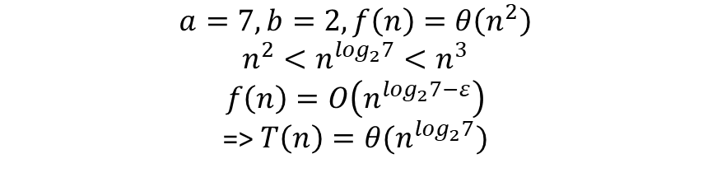

106 成大
Use the master method to give tight asymptotic bounds for the following recursive $T\left(n\right)=7T\left(\frac{n}{2}\right)+θ\left(n^{2}\right),$(10%)
$$a=7,b=2, f\left(n\right)=θ\left(n^{2}\right)$$
$${n^{2}<n}^{\log_{2}7}<n^{3}$$
$$f\left(n\right)=O\left(n^{\log_{2}7−ε}\right)$$
=> $T\left(n\right)=θ(n^{\log_{2}7})$

Slide 6
Q&A

